Slide 1


Statistics Training #1

Slide 2


Setting Up – Data Download
At any point in this session if you need help, please ask ☺ (https://github.com/Nottingham-and-Nottinghamshire-ICS/Statistics_training_1)
Go to our github page using the QR code or through this link (https://github.com/Nottingham-and-Nottinghamshire-ICS/Statistics_training_1)
You will see the different files listed. Download: Data for Statistics Training NNICB - Dummy Discrete and Non-Identifiable Ambulance Continuous.xlsx, Statistics Training Practical R.R, and Statistics Training Answers R.R
To download, click on the file and then click the download image (near the pencil icon towards the middle right. It will say “Download raw file” when you hover over it).
You can download Statistics Training Notes.docx & Statistics Training Presentation.pptx now if you wish, but you don’t need these for the session, they are primarily to allow you to review and refer back after the session. However, you might like to have the notes to supplement the PowerPoint presentation I will go through.
If you don’t download these files now, you can always download them later using the link/QR code to the GitHub page provided in the email sent out before this session. I would really recommend downloading and having a look through the notes word document at some point – it has a lot of useful links and summarises the topics covered well
Github page to download data and required resources

Slide 3
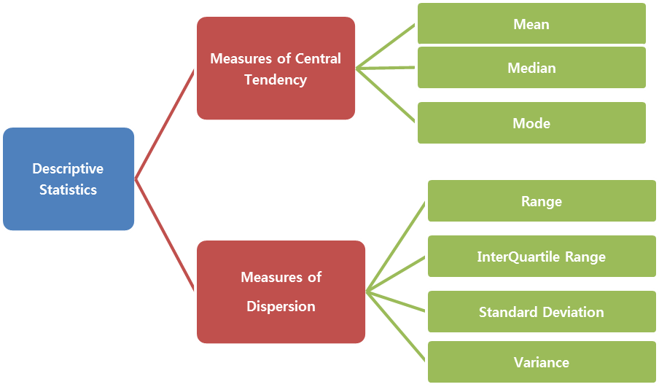
Why Are Data Types Important?
Type of Data Helps Determine How To:
Summarise
Analyse
Visualise
Apply Statistical Methods
DISCRETE
CONTINUOUS
Statistics-Chapter 1: Numerical Measures, accessed 13.07.24
https://medium.com/@Vishva_Shah/statistics-chapter-1-numerical-measures-f0abca02872a

Slide 4
Discrete & Continuous Data
CONTINUOUS
DISCRETE
Quantitative/Numerical
Categorical
Quantitative/Numerical
Pain rating scale
Length of stay (LOS)
Birth weight
Patients in ED (ED occupancy)
Doctors in a workforce
Ethnicity
Binary (e.g. has disease, does not have disease)
Ambulance handover time

Slide 5
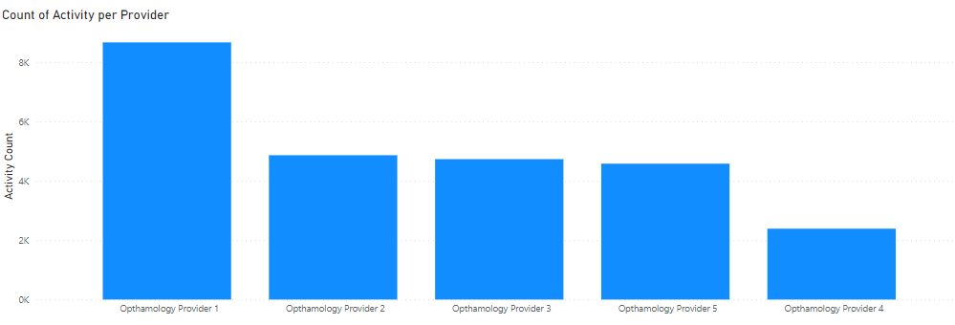

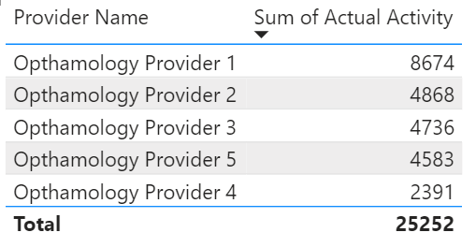
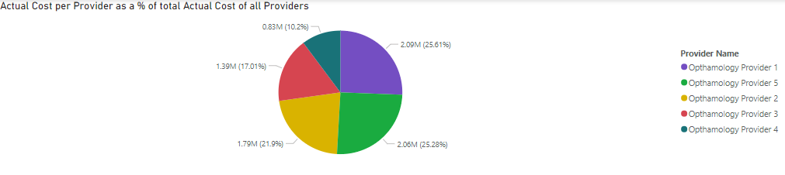
Discrete Data
NOT A HISTOGRAM
QUESTION: WHAT’S THE DIFFERENCE BETWEEN A BAR CHART AND COLUMN CHART?

Slide 6
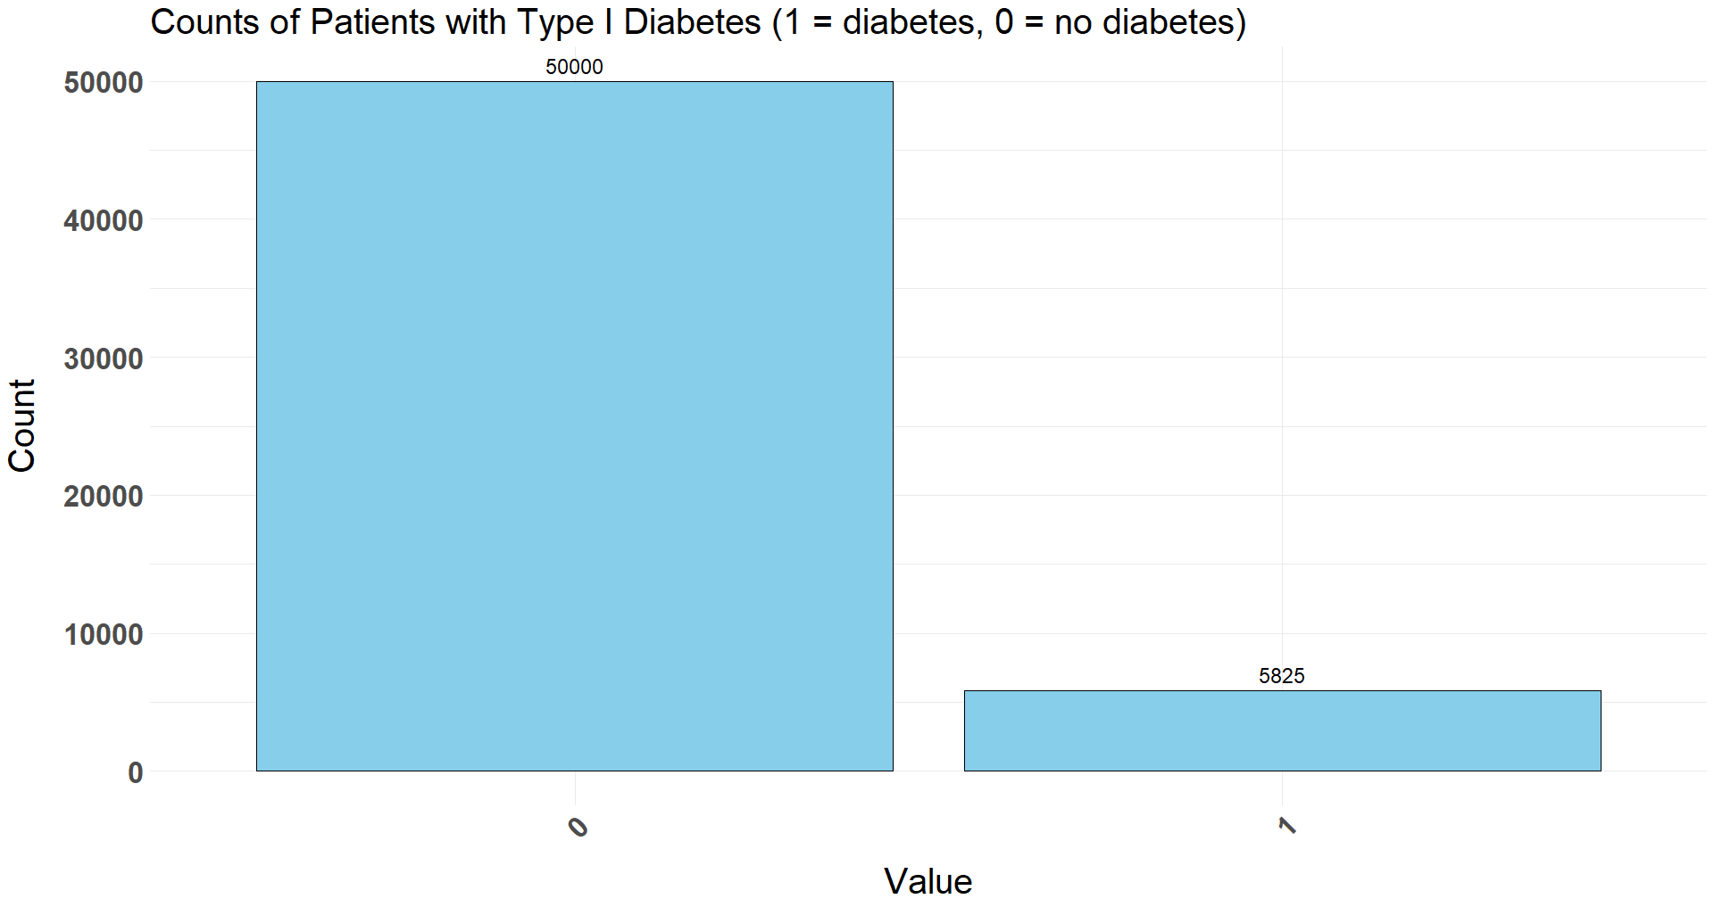
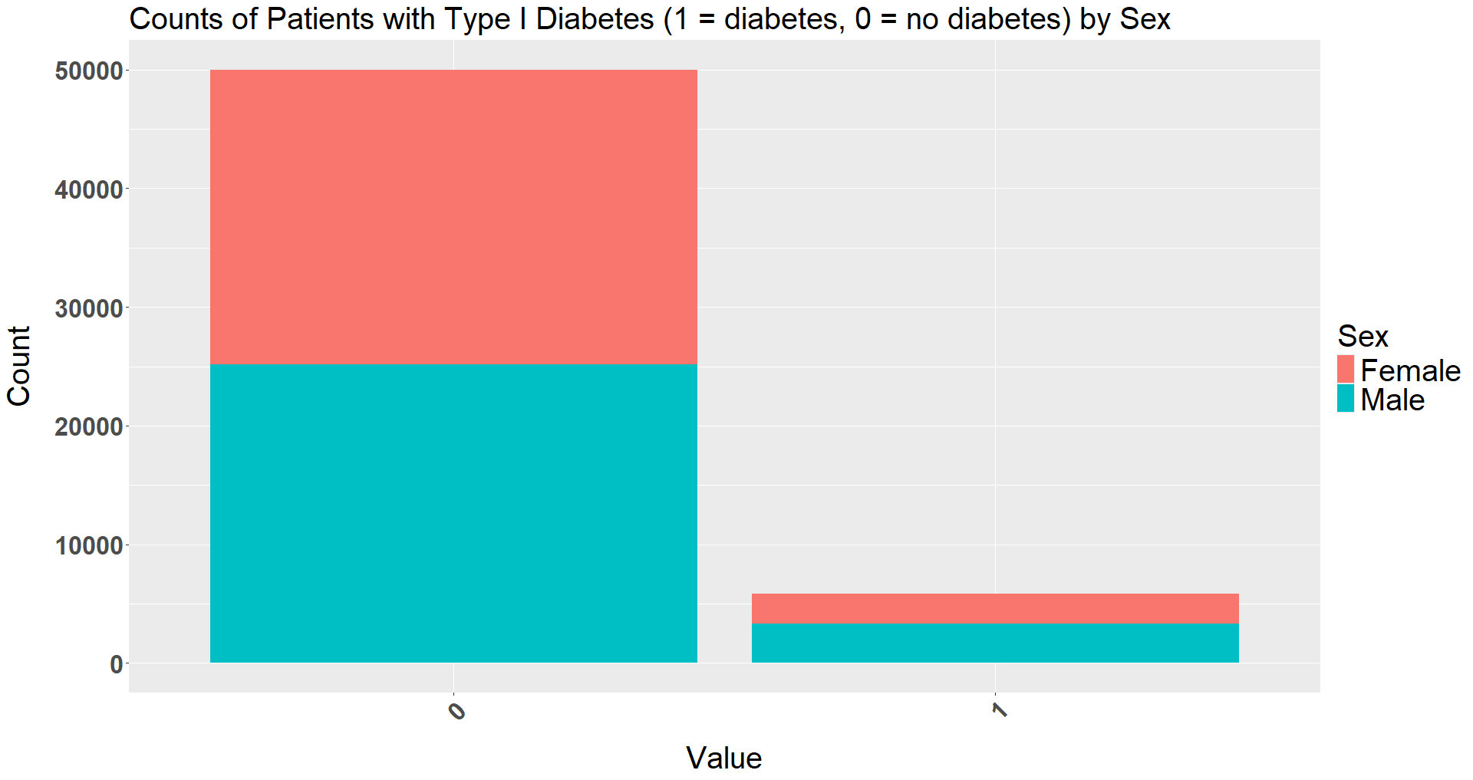
Discrete Data

Slide 7
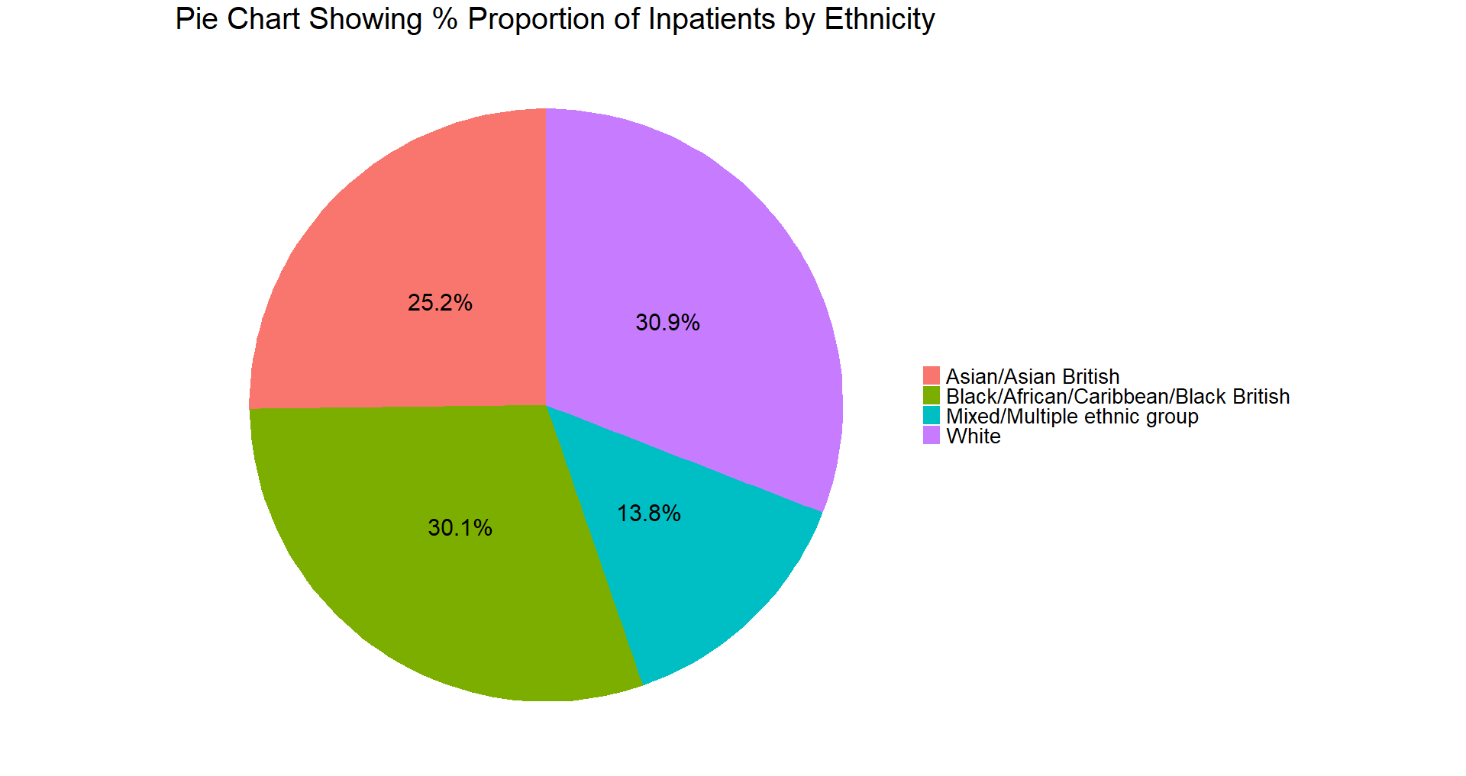
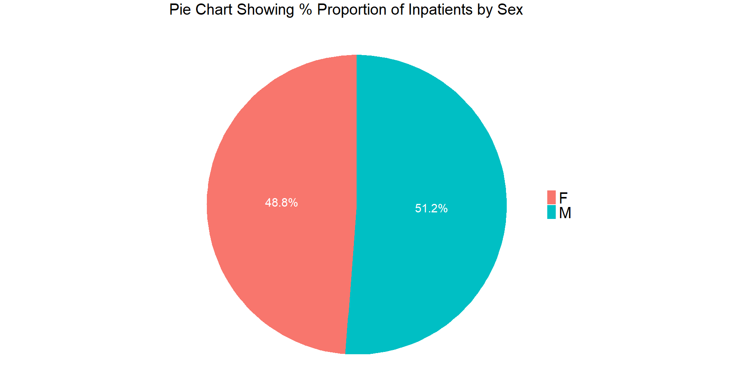
Discrete Data

Slide 8
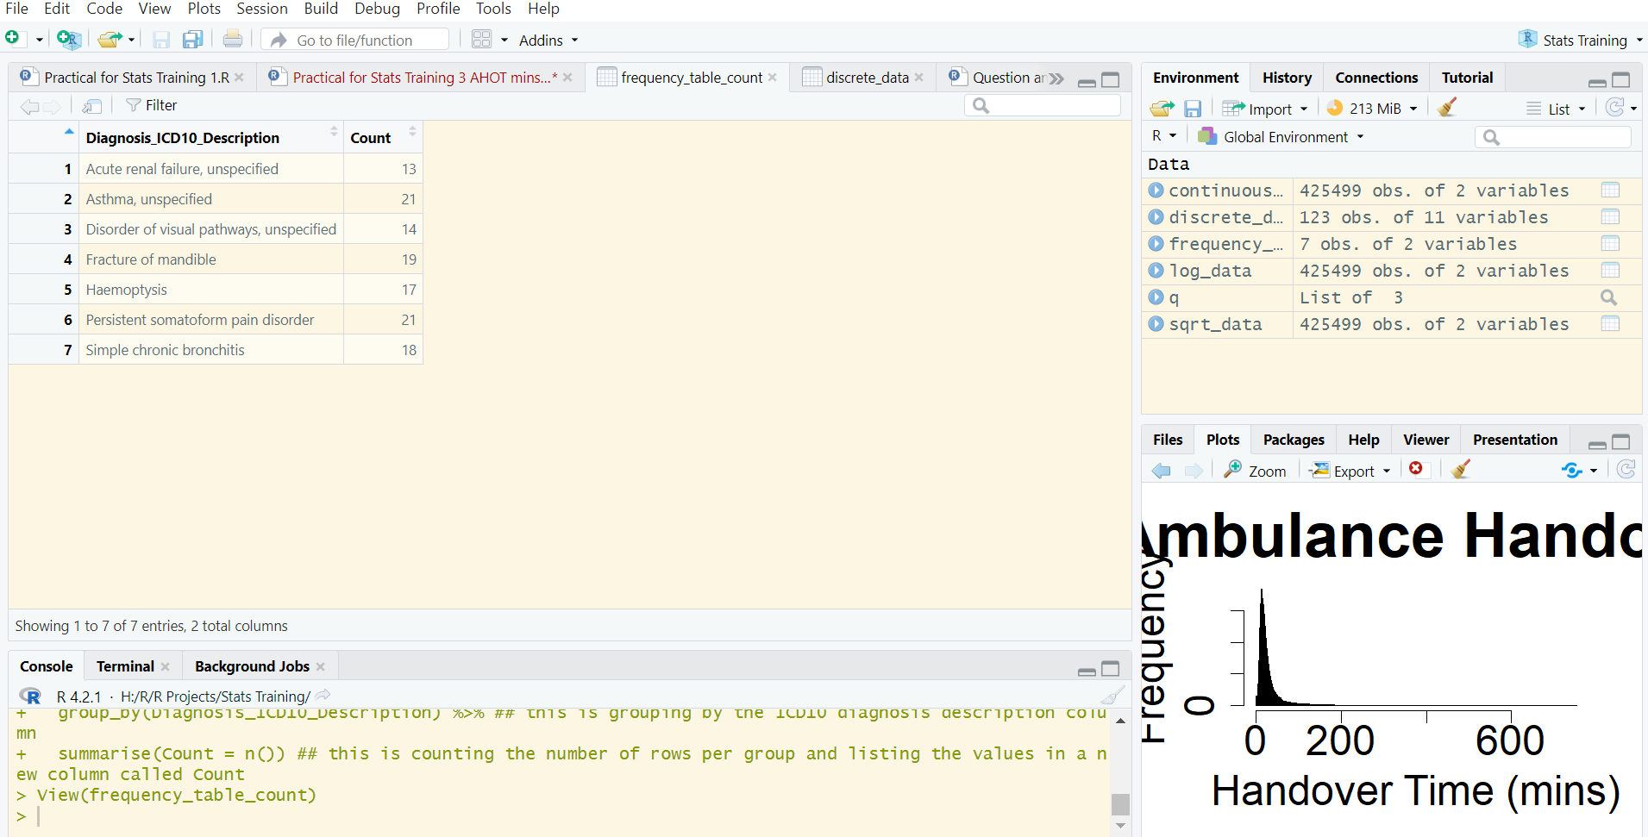
Setting Up – R
Open Rstudio and create a new project by selecting file, new project, new directory, new project, and then typing your project name in the top text box (e.g. Stats training 1). You also need to select where you will save the project in the lower box (click browse). It’s a good idea to have one dedicated folder where you keep all of your R projects. Click create project.
Save all the files you downloaded in the R Project by copying the files from your downloads and navigating to the R Project in your file explorer. You should see a RPROJ file. Paste the files inside the project
Comments throughout the R file are essential to understand the code – please read them! If anything doesn’t make sense, please ask
Run lines 4-24 (highlight and ctrl+enter) to install the required packages, read the libraries, and read the data. Sometimes you can run code line by line (highlight the line and cntr+enter) to better understand what each line of code does.
Click Environment, discrete_data to familiarise yourself the data we will use next. If you get a chance, also take a look at the continuous data (using this later)
Note: the Data for Statistics Training NNICB - Dummy Discrete and Non-Identifiable Ambulance Continuous.xlxs file contains 2 additional tabs with Excel questions and model answers. If you wish to have a go at any of the practical elements that we will do together in R, but in Excel in your own time, you can follow this

Slide 9
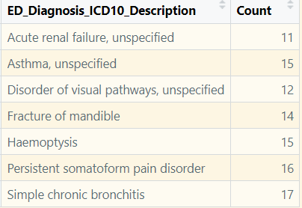
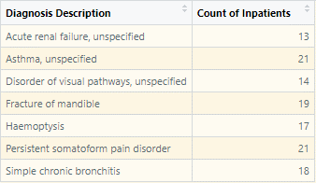
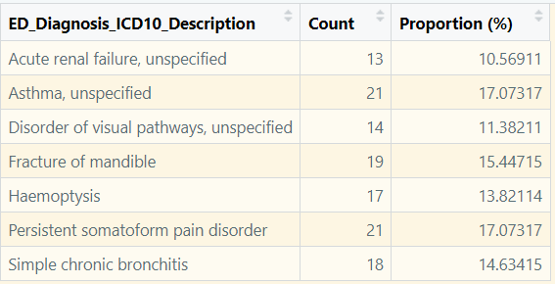
Discrete Data Practical – Frequency Tables Part 1
Run lines 36-39 (highlight & cntrl+enter) to create the first frequency table which counts the number of inpatients with each diagnosis. Have a look at the output (opens in new window)
Run lines 44-48 to create the same frequency table, but with proportions as well instead of just raw values
What do these tell us?
Have a go at question 1 (lines 53-63) to rename the ICD10 column to something easier to understand

Slide 10
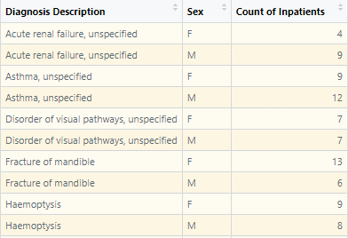
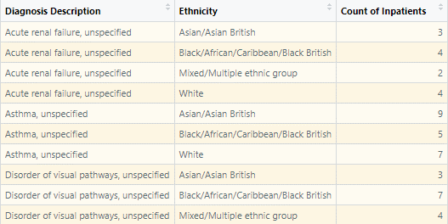
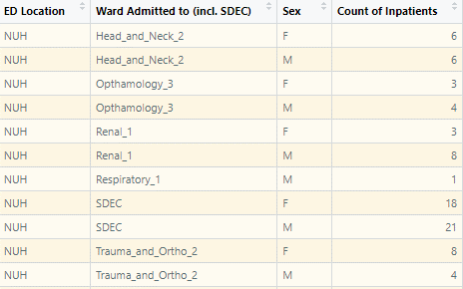
Discrete Data Practical – Frequency Tables Part 2
Run lines 69-76 by highlighting and pressing ctrl+enter to create a new frequency table that is split by diagnosis and sex, and to rename the columns and view the table. You can now see the counts of inpatients with each diagnosis, split by sex
Have a go at task 2 (lines 79-89) to split the data by ethnicity instead of sex. There are some hints in the R file next to the task in case you get stuck.
Have a go at task 3 (lines 94-111) to create your own frequency table. If you get stuck, ask for help or have a look at the Statistics Training R.R file, but try to do it on your own first.

Slide 11
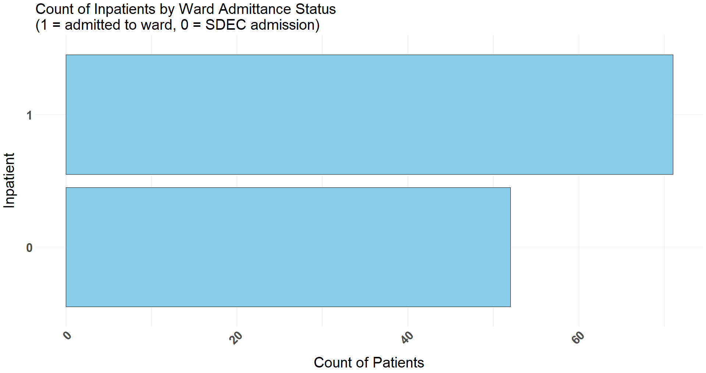
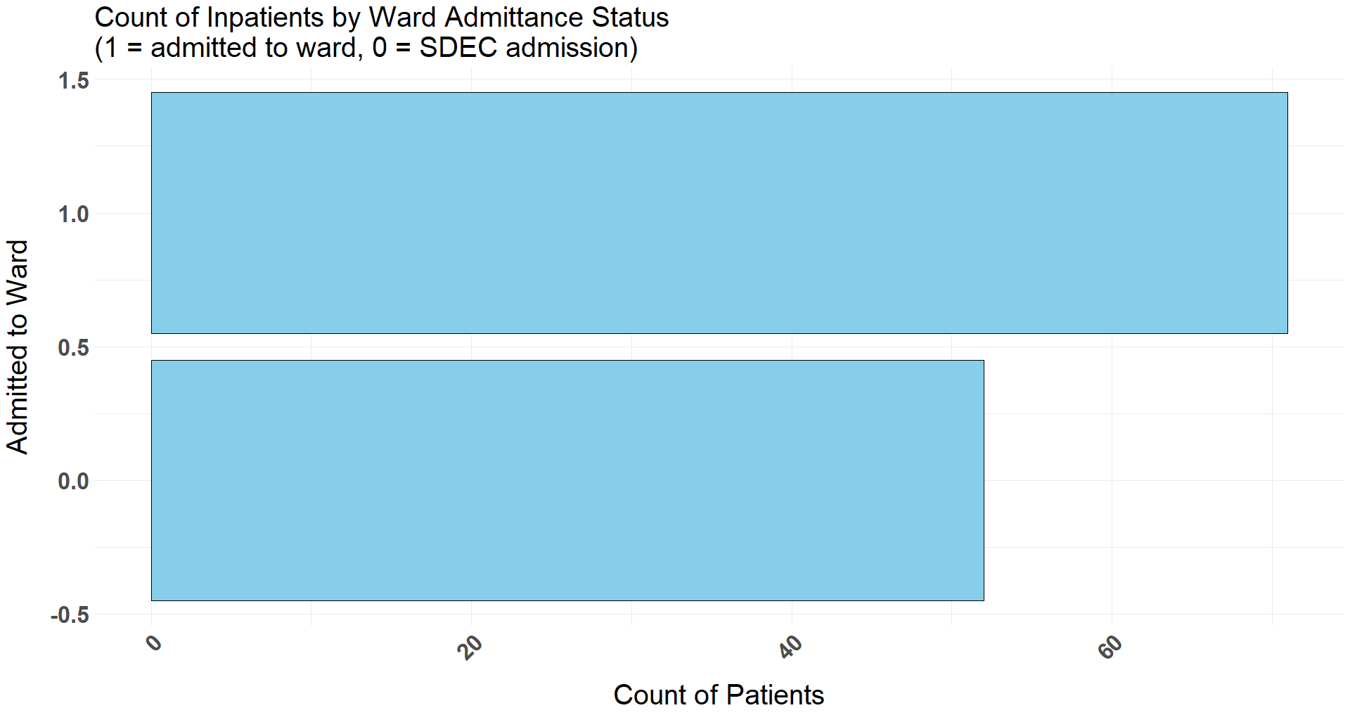
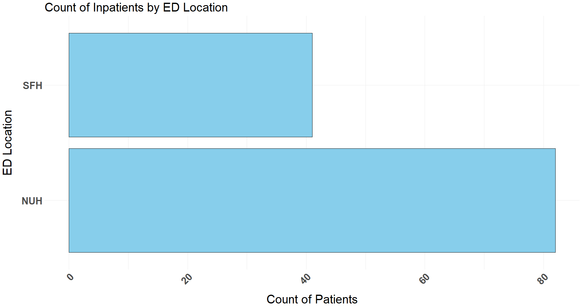
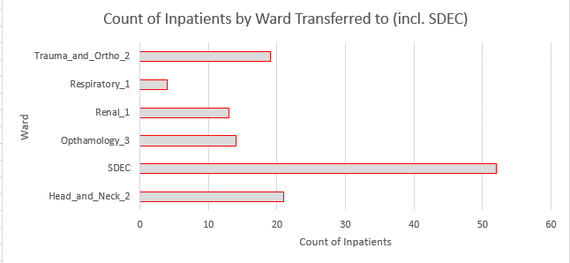
Discrete Data Practical – Bar Charts Part 1
Run lines 123-126 to make a simple column chart showing the count of patients per ED location that they arrived to.
Then run lines 131-142 to run customised code that creates a bar chart. Remember to read the comments!! You could have a go at editing some of the parameters inside theme()
Run lines 146-158 to create a bar chart that shows the number of inpatients that were admitted to a ward (rather than SDEC).
Have a go at question 4 and then we will discuss the answers together.
Run line 170-180 to convert the categorical variables to factors, and then run lines 185-197 to create the improved bar chart
Have a go at the task 5 (lines 200-218) to create a new bar chart

Slide 12
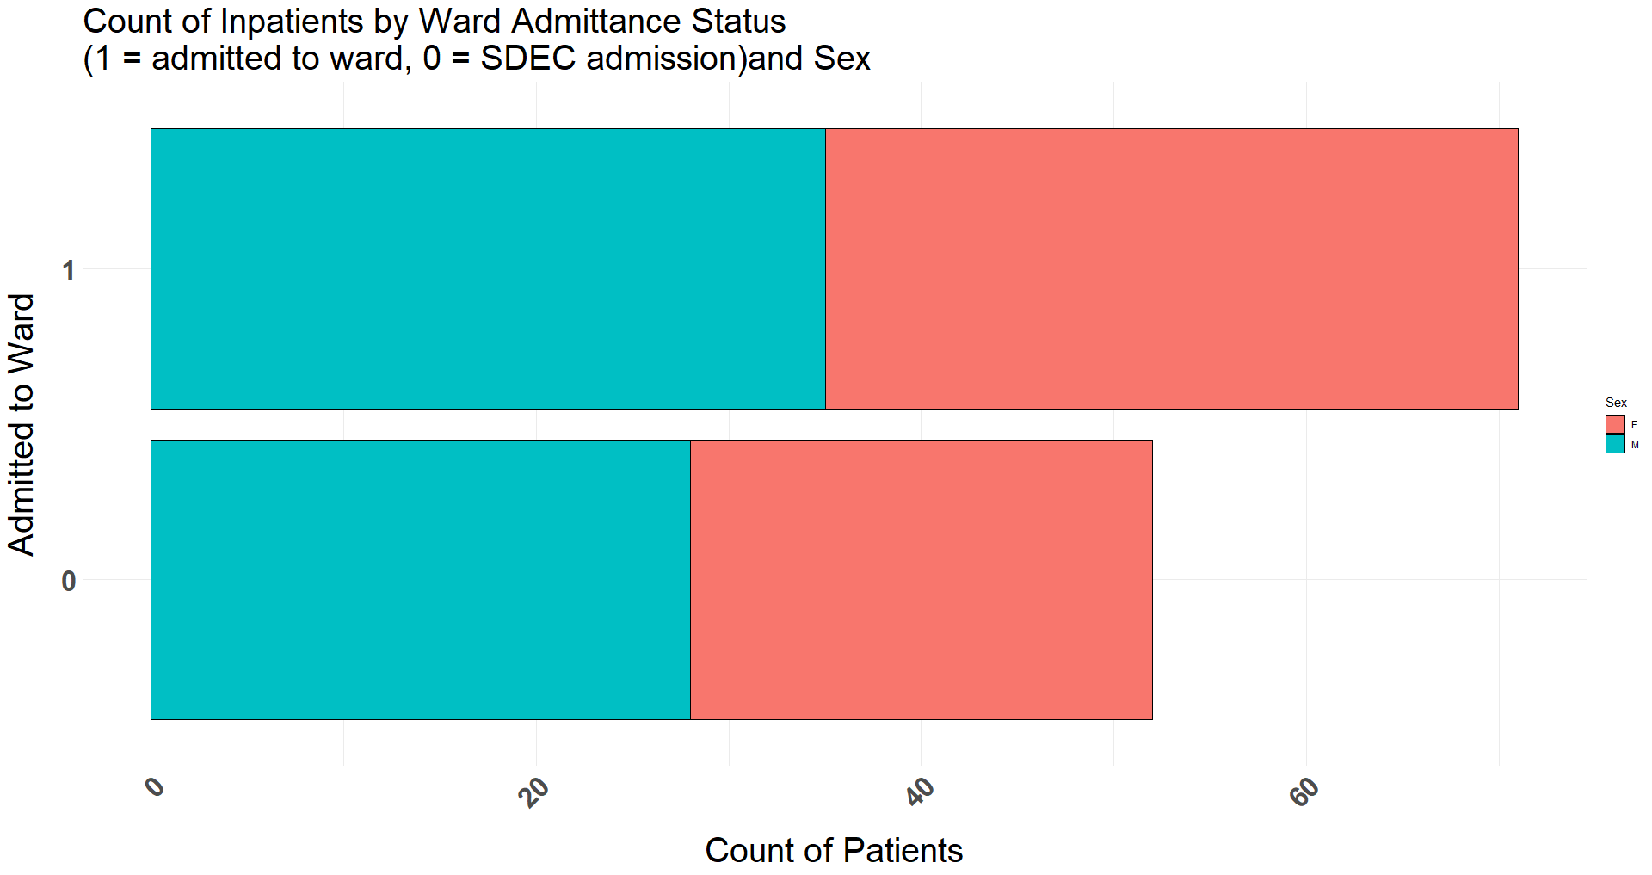
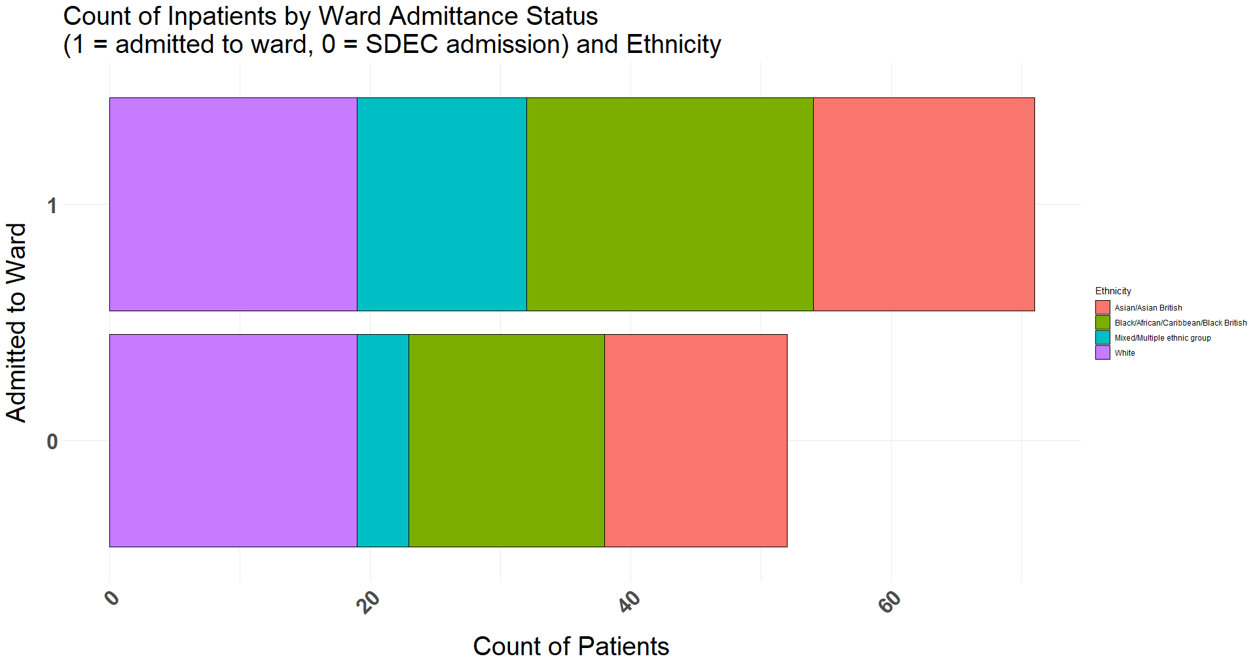
Discrete Data Practical – Bar Charts Part 2
Run lines 225-241 to create a stacked bar chart showing the number of patients that were admitted to a ward (rather than SDEC), split by Sex. We are only adding few extra lines of code. Check the comments to understand the changes
Have a go at task 6 (lines 244-263) to split the bars by ethnicity

Slide 13
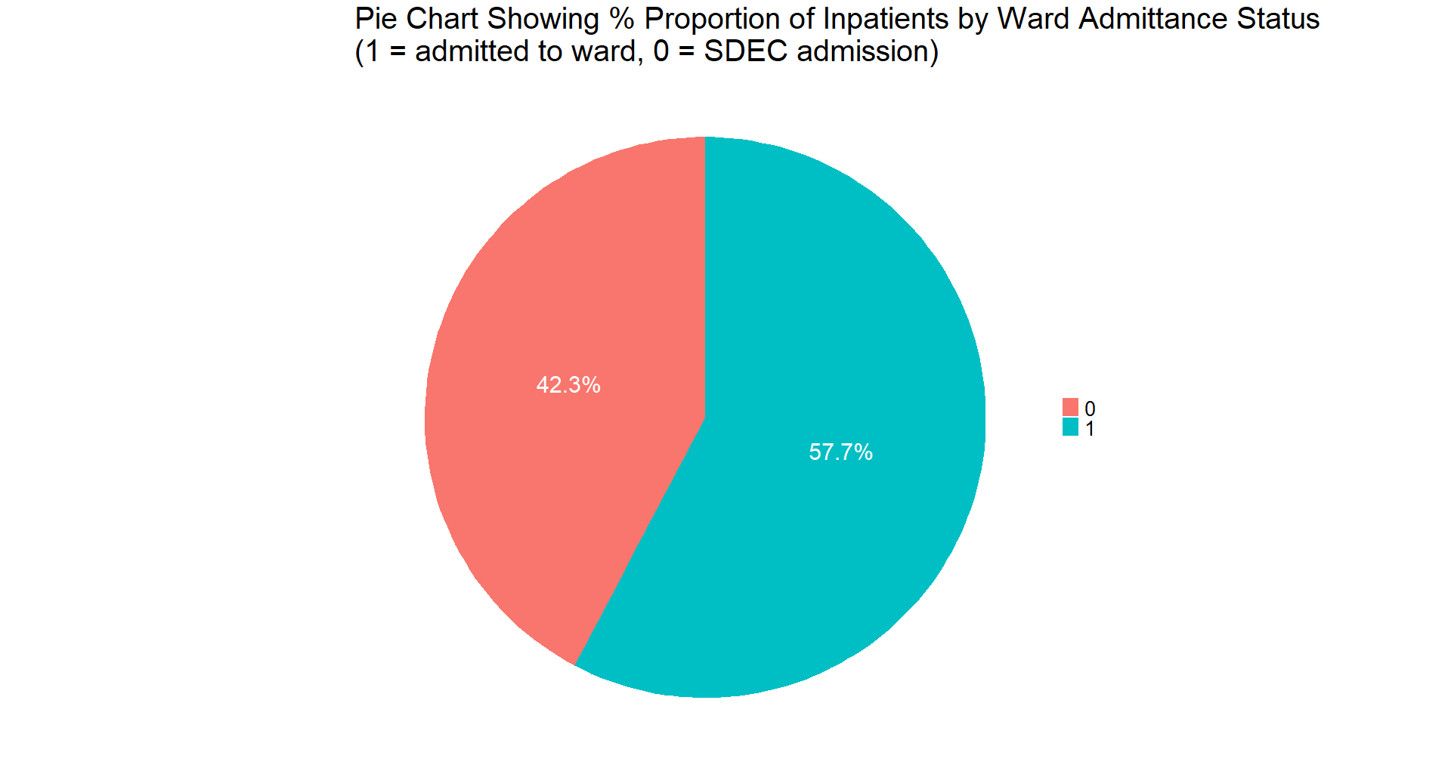
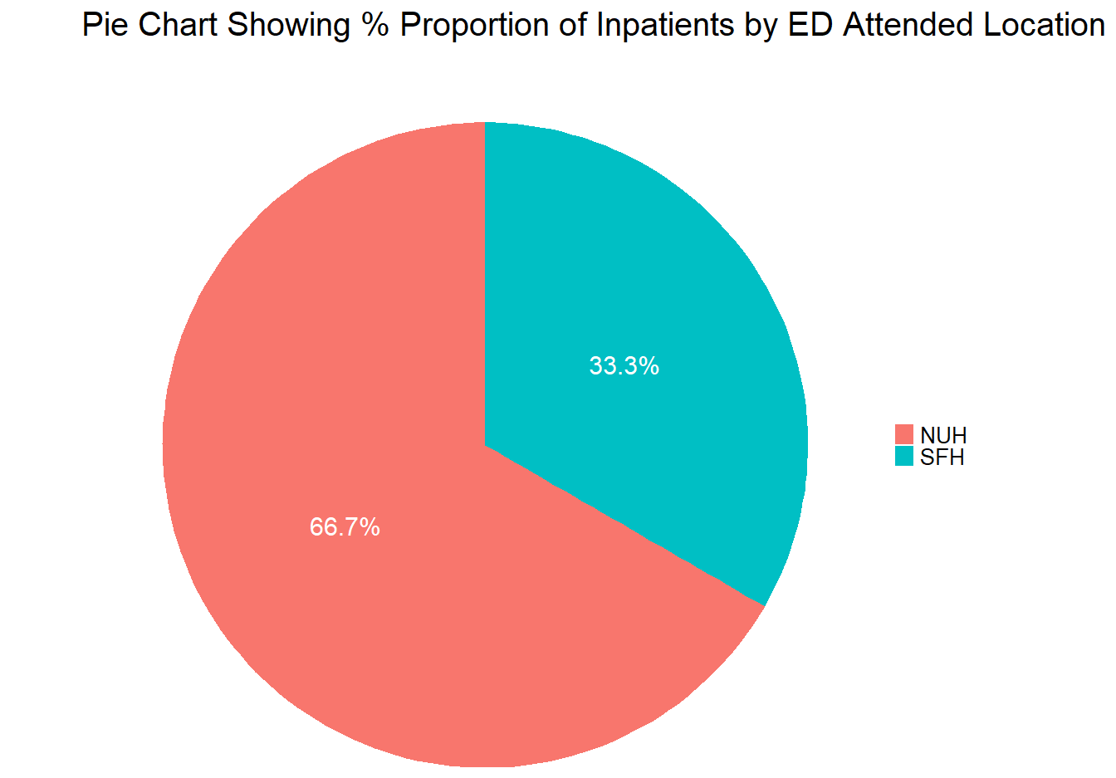
Discrete Data Practical – Pie Charts
Run lines 274-278 to re-run the frequency proportion table from earlier. Line 278 adds in a new column that we can use for the data labels on our chart.
Run lines 283-287 to create a simple pie chart.
Run lines 290-300 to create a more customised pie chart. Remember to read the comments to understand each line of code. You can have a go at changing some things if you want to play around
Have a go at task 7 (lines 307-327) to make a pie chart showing the ED_Location split. This task might be a bit more tricky than the previous as in the chart there are lots of elements that you have to change. Have a go and look at the hints or ask for help if you get stuck

Slide 14
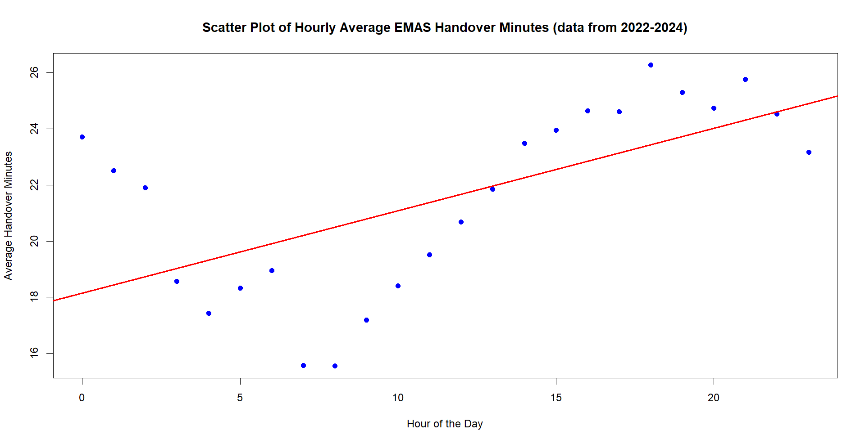
Continuous Data

Slide 15
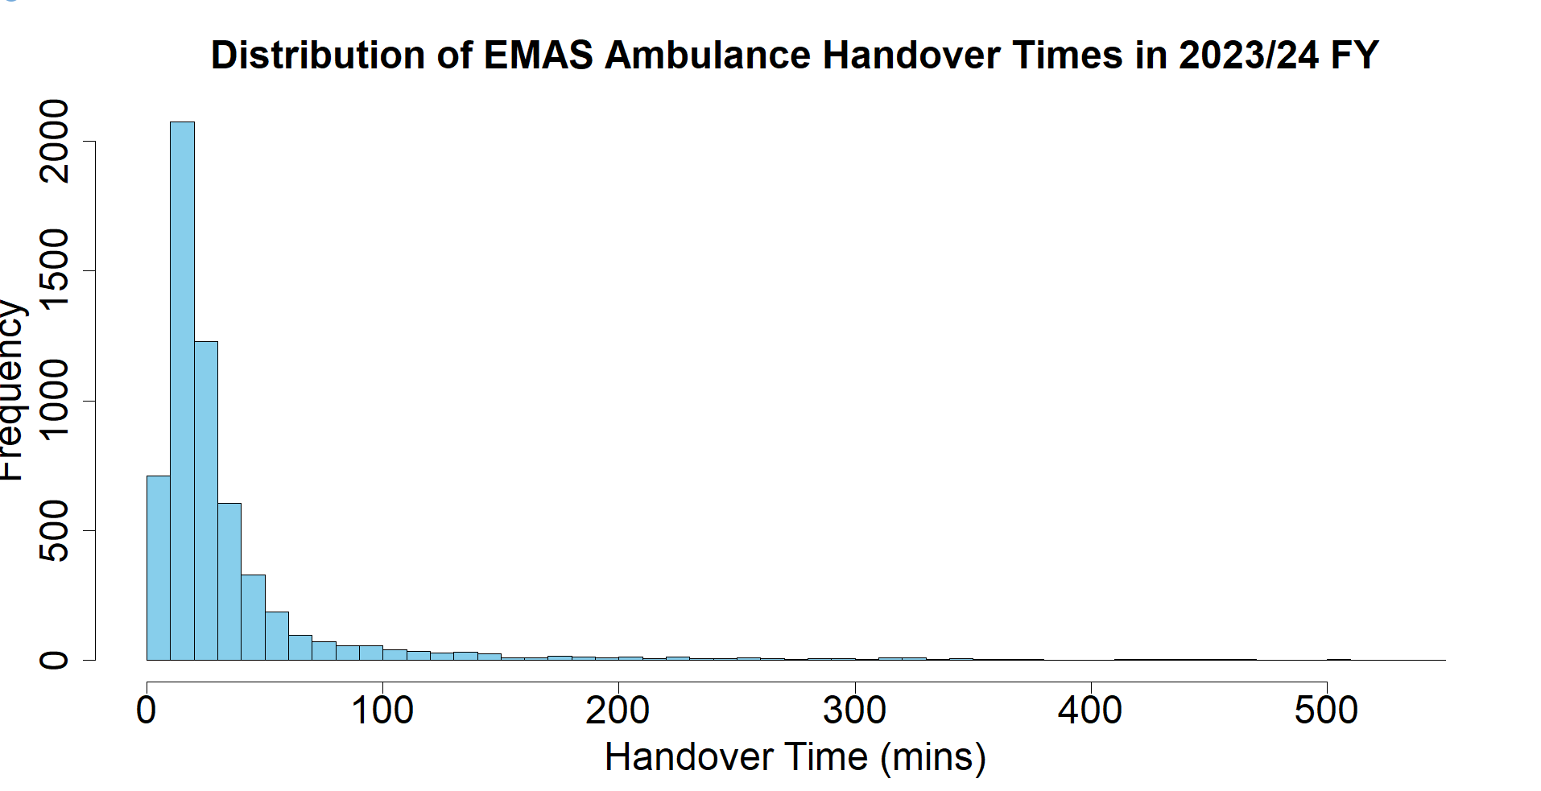
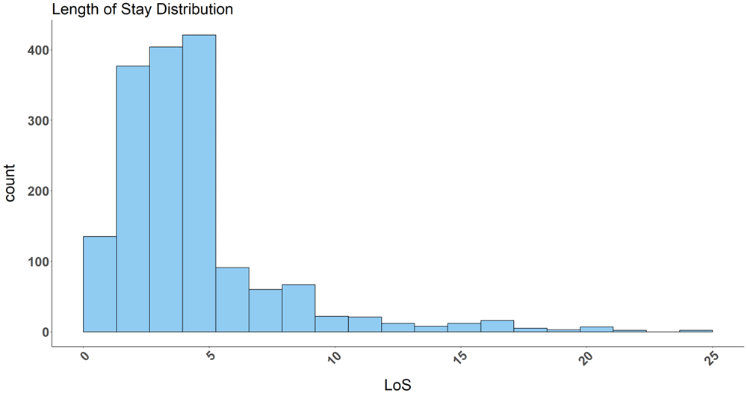
Continuous Data
QUESTION: WHAT DO WE MEAN BY DATA BUCKETS/BINS?

Slide 16

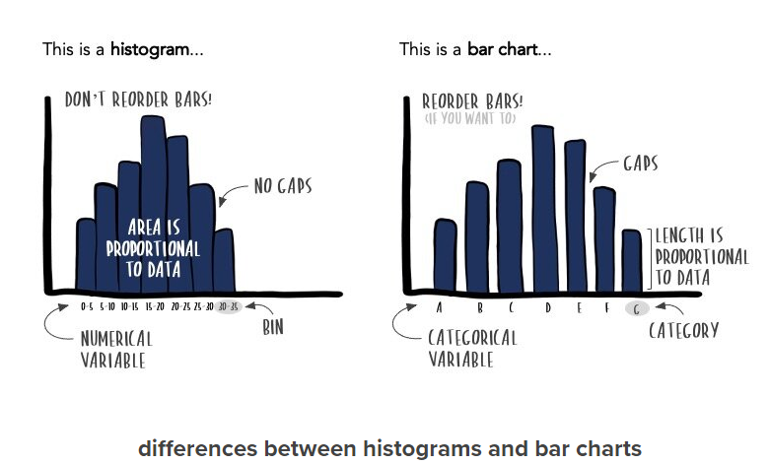

Continuous Data – Histogram vs Bar/Column Chart
StorytellingWithData, accessed 03.07.24 https://www.storytellingwithdata.com/blog/2021/1/28/histograms-and-bar-charts

Slide 17
Continuous Data Practical – Histograms
Run lines 349-360 & have a look at the histogram. What does it tell you?
Read the comments to see how to complete the necessary steps required to build a histogram e.g. selecting the bin method
Have a go at task 8 (lines 364-396) to use different binning methods. Please feel free to ask for help if required (but also make sure to have a read of the comments, they should help!)
DISCRETE OR CONTINUOUS?
Ambulance handover times in minutes =
Length of stay in days:hours:minutes:seconds =
Length of stay in days =
Birthweight in pounds =
C
C
D
C

Slide 18
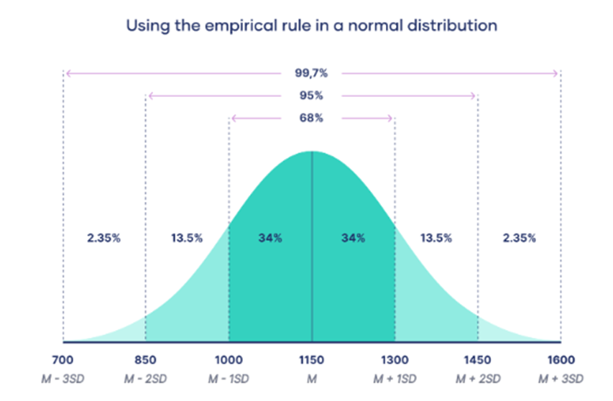
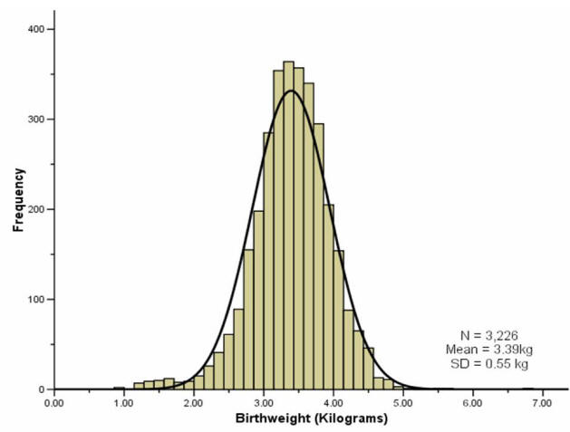
Normal Distribution
MEAN = MEDIAN = MODE
Scribbr, accessed 01.07.24 https://www.scribbr.co.uk/stats/the-normal-distribution/
Why does normal distribution matter?
It is quite common, therefore many statistical tests e.g. ANOVA, t-test etc. assume your data is normally distributed.
Using inferential statistics, you can make educated estimations about a larger population than your sample.
-ve infinity
+ve infinity
UK Faculty of Public Health, accessed 03.07.24 https://www.healthknowledge.org.uk/public-health-textbook/research-methods/1b-statistical-methods/statistical-distributions

Slide 19
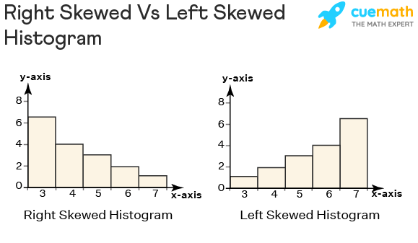
Skewed Distribution
POSITIVELY/RIGHT SKEWED
POSITIVELY/RIGHT SKEWED
cuemath, accessed 01.07.24 https://www.cuemath.com/data/right-skewed-histogram/

Slide 20
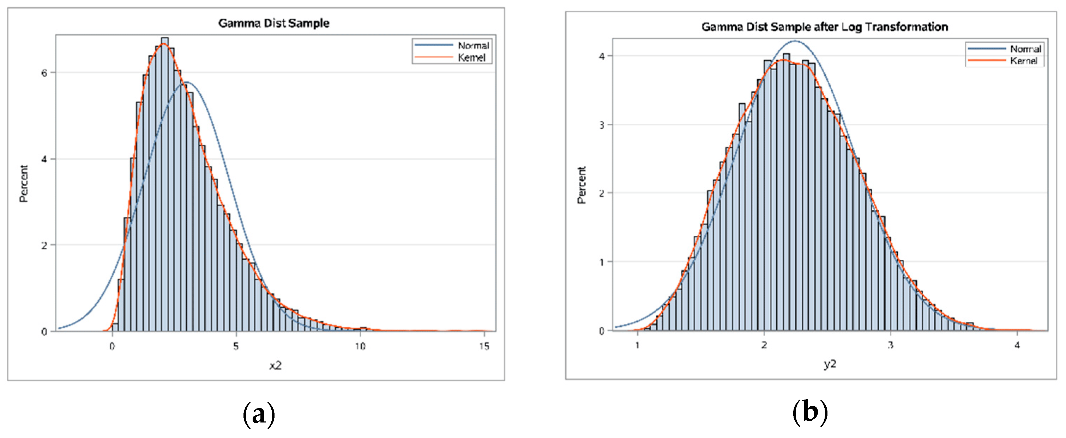
Skewed Distribution – Log Transformation
Handling Skewed Data: A Comparison of Two Popular Methods accessed 01.07.24 https://www.mdpi.com/2076-3417/10/18/6247

Slide 21
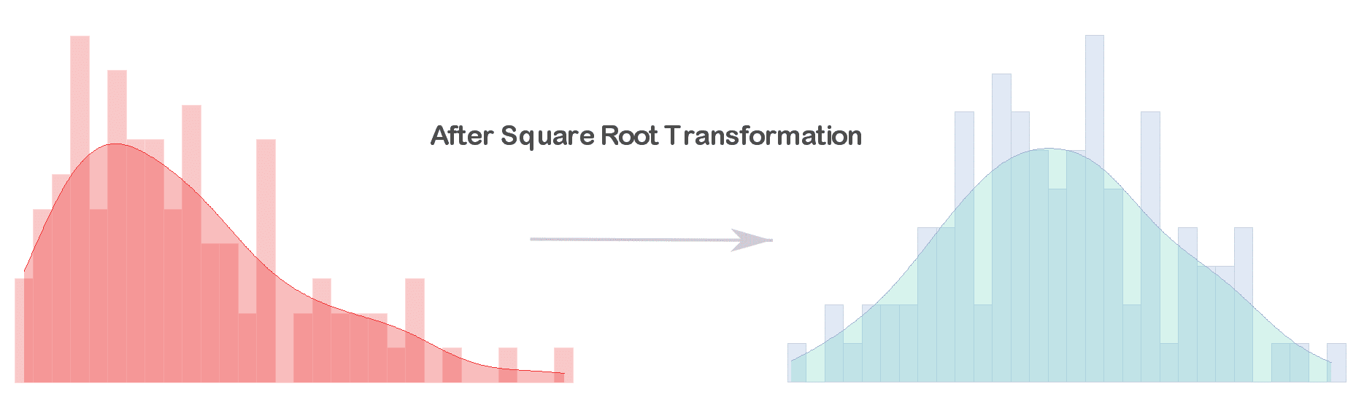
Skewed Distribution – Square Root Transformation
Quantifying Health, accessed 01.07.24 https://quantifyinghealth.com/square-root-transformation/

Slide 22
Summary Measures – Measures of Central Tendency
Measure | Description | Suitable Data Types
Mean | Average that helps indicate the centre of the data Sum all values and divide by number of values Can be heavily skewed by outliers | Normally distributed continuous Numerical discrete that does not have very high or very low outliers E.g. Birthweight, square-root transformed ambulance handover times
Median | Centre of the data set when values are arranged in numerical order | Skewed continuous Discrete numerical with outliers in data E.g. LOS
Mode | The most frequent value | Not used very often Useful in epidemiology e.g. to find the most common virus during an outbreak

Slide 23

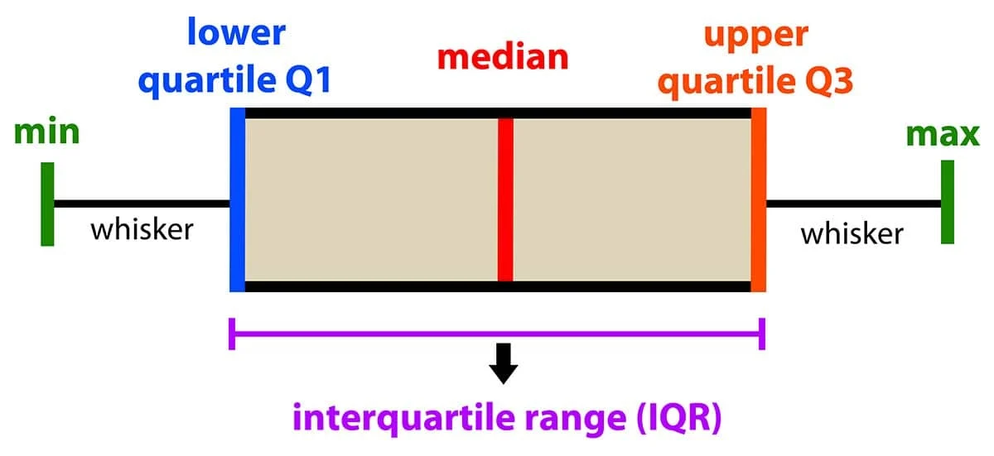
Summary Measures – Measures of Data Spread
Measure | Description | Suitable Data Types
Range | Smallest value subtracted from largest value Helps understand variability in data Is skewed by even 1 very high or very low outlier | Normally distributed continuous Numerical discrete without outliers
Interquartile Range | Q3 – Q1 Arrange data in ascending order. Median = Q2. Median of data left of Q2 = Q1. Median of data right of Q2 = Q3 Describes middle 50% of data Not affected by outliers | Skewed continuous Numerical discrete with outliers
Standard Deviation | Square root of the variation Measures how spread out the data is, relative to the mean Higer SD can indicate more volatility in data Useful for comparing consistency between 2 data sets | Normally distributed continuous Compare between data sets – 2 sets of data could have same mean, median, range, but have very different data. SD would help highlight this.
Australian Beureau of Statistics, accessed 01.07.24 https://www.abs.gov.au/statistics/understanding-statistics/statistical-terms-and-concepts/measures-spread#:~:text=and%20concepts%20glossary-,Definition,range%2C%20variance%20and%20standard%20deviation.
SimplyPsychology, accessed 01.07.24 https://www.simplypsychology.org/boxplots.html

Slide 24
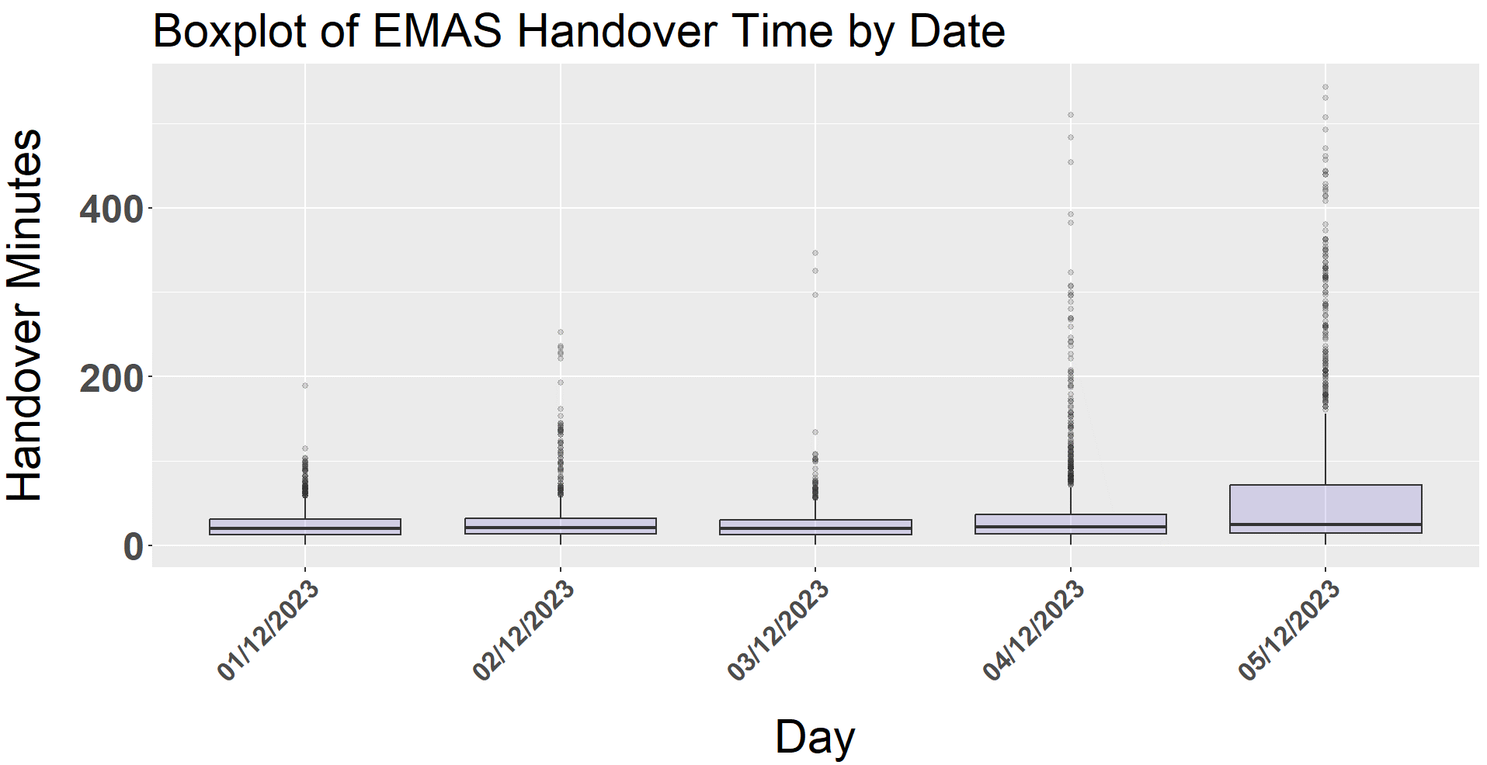
Summary Measures – Box Plot Practical
Run lines 409-420 to create a box plot (remember to read comments to understand each line of code)
Have a go at answering question 9 about the box plot (we will go over answers in the next slide)
SimplyPsychology, accessed 01.07.24 https://www.simplypsychology.org/boxplots.html

Slide 25
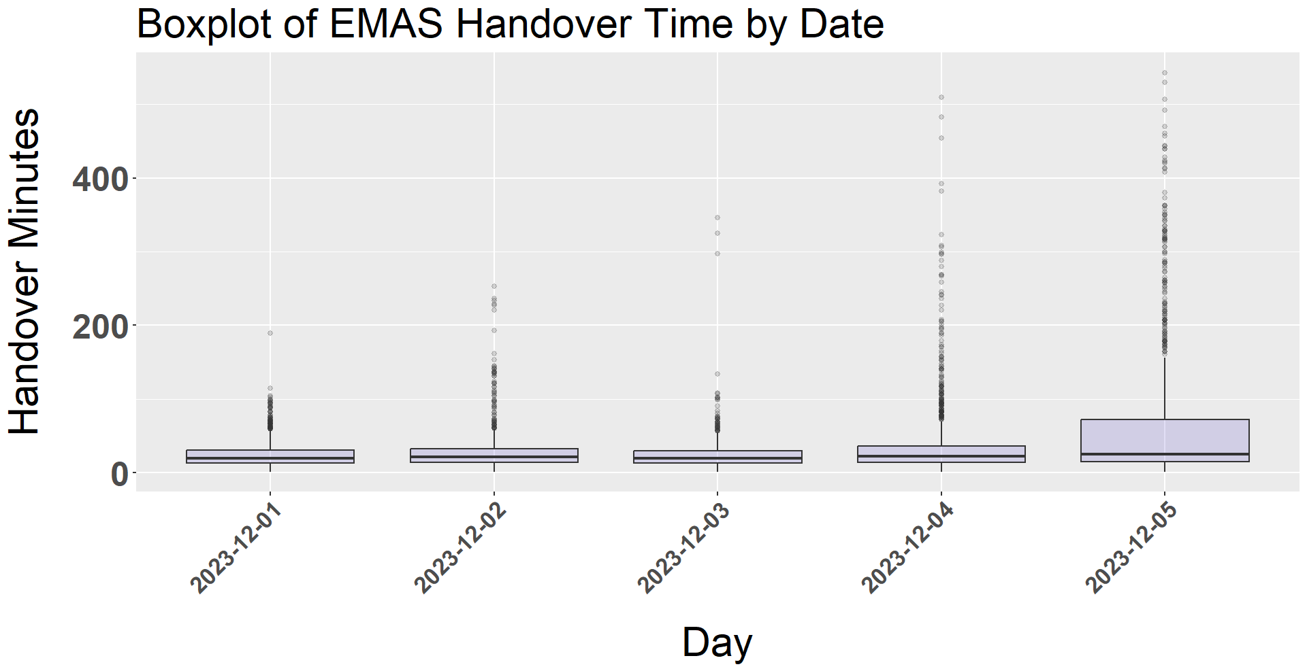
Summary Measures – Box Plot Practical
QUESTIONS:
1: Which day has the single highest handover time value (excl. outliers – ignore dots)?
2: How would you describe the median/Q2 value across all 5 days?
3: Which day has the highest Q3 value?
4: How would you describe the Q1 value across all 5 days?
5: Which day has the largest spread across the middle 50% of the data?
2023-12-05
ADD X1.5
Fairly constant
SUBTRACT X1.5
2023-12-05
Fairly constant
2023-12-05

Slide 26

Summary Measures – Basic Summary Measure Overview Practical
Run line 436 to produce a simple summary of the columns in continuous_data
Run line 438 to run summary measures of just the Handover_Minutes columns, as this is what we would probably be the most interested in
Have a look at the different measures and what they indicate about the data. Are they what you expected? Does anything surprise you?

Slide 27
Summary
 | DISCRETE DATA |  |  | CONTINUOUS DATA
 | Categorical | High Variance Numerical | Low Variance Numerical | Normal Distribution | Skewed Distribution
Visualisations | Bar/column charts Pie charts Frequency tables | Bar/column charts Pie charts Frequency tables Box plots (IQR) | Bar/column charts Pie charts Frequency tables | Histogram Scatter plot (2x continuous variables) | Transformed(e.g. log, square root etc.) histogram Scatter plot (2x continuous variables)
Measures of Central Tendency | N/A | Median | Mean Median | Mean Median | Median
Measures of Data Spread | N/A | Interquartile range | Range | Range Standard deviation | Interquartile range

Slide 28
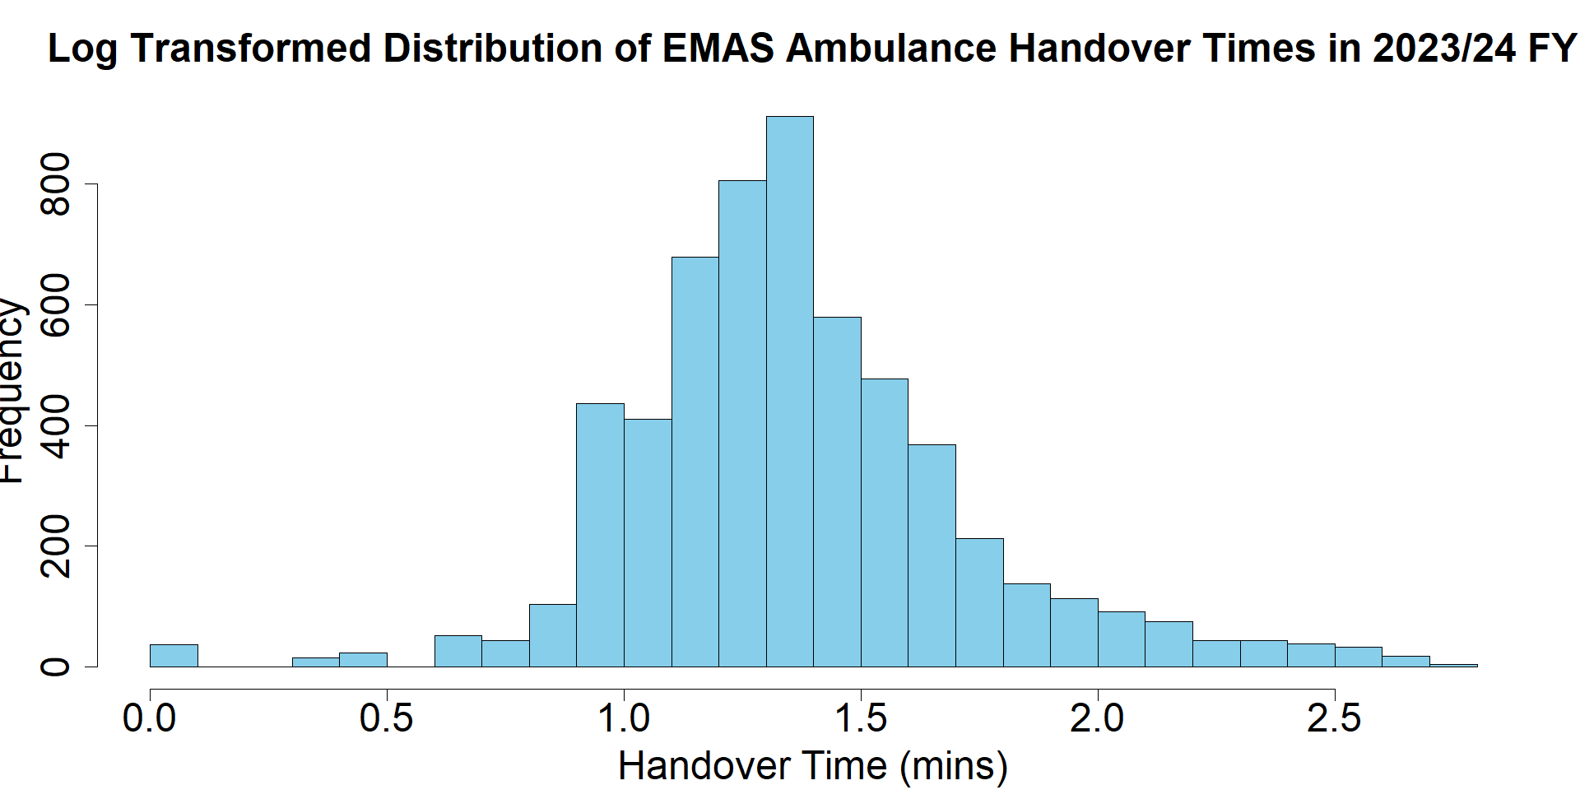
Skewed Distribution – Log Transformation Practical
Run lines 444-446 to prepare the data and generate the log transformed data
Run lines 454-464 to create the log transformed histogram
Have a go at question 10 (line 462). We will go over the answers together on the next slide
QUESTION: HOW WOULD WE DESCRIBE THE LOG TRANSFROMED EMAS FREQUENCY DISTRIBUTION?

Slide 29
Skewed Distribution – Log Transformation Practical
Notes:
Log transformation – if you have a lot of values at lower values especially – can get gaps between bars. Will have happened due to higher concentration of handovers around 15 min mark. But looks better, more normally distributed.

Slide 30
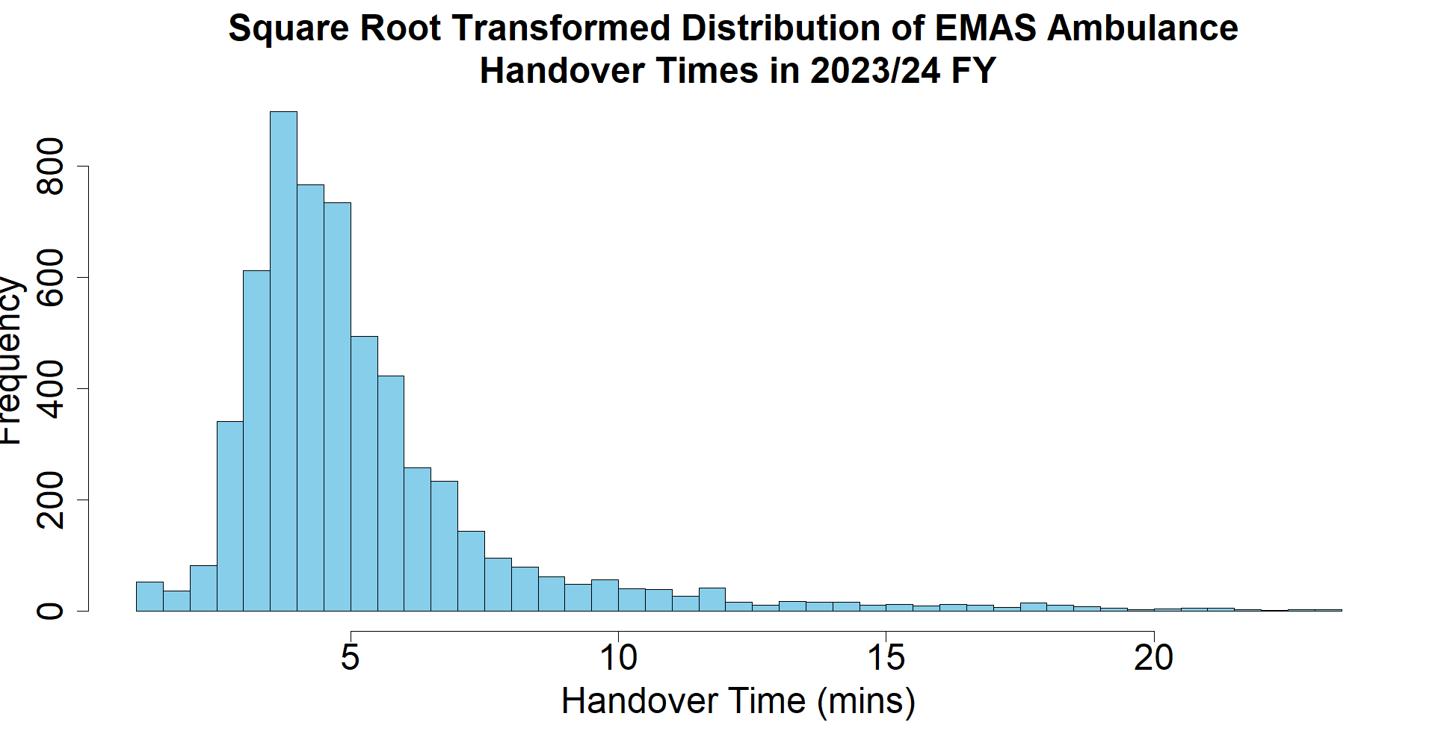
Skewed Distribution – Square Root Transformation Practical
Run lines 471-473 to prepare the data and generate the square root values
Run lines 476-487 to create the transformed histogram
Have a go at question 11 (line 491) and we will go through answers together on the next slide
QUESTION: HOW WOULD WE DESCRIBE THE SQUARE ROOT TRANSFROMED EMAS FREQUENCY DISTRIBUTION?

Slide 31
Skewed Distribution – Square Root Transformation Practical

Slide 32


Feedback
I would welcome any feedback (especially constructive) regarding how this session could be improved in the future. You can also contact me on amy.makawana1@nhs.net
QR code to feedback survey
If you could fill out the survey now, we would really appreciate it. It should only take 5 minutes. Thank you!!

Slide 33
Contact & Resources
We really hope you enjoyed this training and found it useful. Please feel free to reach out with any questions. You can contact me with feedback and/or questions on amy.makawana1@nhs.net
There is a comprehensive list of resources available in the Statistics Training Notes Word document available via the GitHub page:
A Reminder of Resources Available from this Training Session:
Statistics Training Notes Word document
This PowerPoint
Data for Statistics Training NNICB Excel Document:
Data for both R and Excel practicals
Excel model answers
Excel questions & tasks answers
Statistics Training Practical R file
Statistics Training Answers R file
The NNICB Stats Training Github page!

